Slide 1
Rating Prediction
Classification Problem

Slide 2
Problem Statement
The client has a website where their customers write reviews for the technical products. Now the client wants to add a rating (stars) feature. The ratings are 1 star,2 stars,3 stars,4 stars,5 stars.
The client wants to predict the rating for the reviews written in past and they don't have ratings.
So our task is to scrap reviews with ratings for the technical products from different websites and build an ML model to predict the past reviews from the client website.

Slide 3
Skills Used
Language used to scrap the data is Selenium webdriver.
Language used for this project is Python.
Libraries required for this project are Pandas, Sickit-learn.

Slide 4
Data Set
The data is collected from amazon and flipkart (reviews with ratings for technical products)
The scrapped data set contains 30424 customer reviews with ratings

Slide 5
Data Cleaning
Used NLP techniques to clean the data.
Regular expression is used to convert numbers into words, remove punctuation.
Stopwords technique used to remove stopwords.

Slide 6
Data Cleaning
Original data set length is 2754264.
Cleaned data set length is 1932821.
Removed unwanted data length is 821443.

Slide 7
Changing text to numeric.
We have different bag of words techniques from NLP to treat the text data and convert it into vectors. Because we need numeric data to train the model.
Here we used Tf-Idf technique to convert the text data into vectors.

Slide 8
ML Algorithms
I used 4 algorithms to train the model.
They are:
**LogisticRegression
**SVC
**KNN
**Naïve bayes

Slide 9
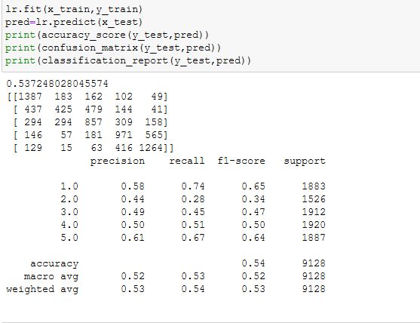
Output of Algorithms
Logistic Regression:

Slide 10
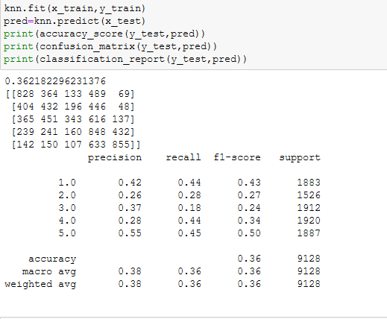
Output of Algorithms
KNN

Slide 11
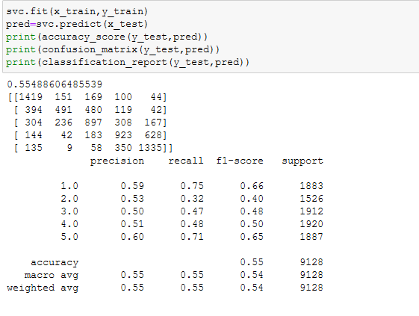
Output of Algorithms
SVC

Slide 12
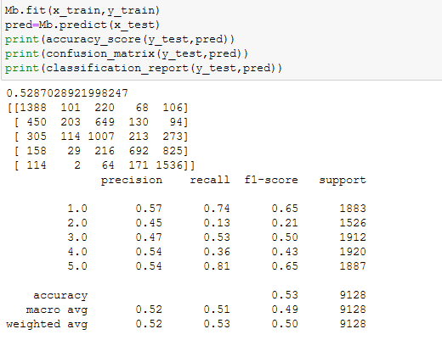
Output of Algorithms
Naïve Bayes

Slide 13
Compare scores
From the 4 algorithms it shows that SVC is working better with better accuracy and F1 score when compared with other algorithms.

Slide 14
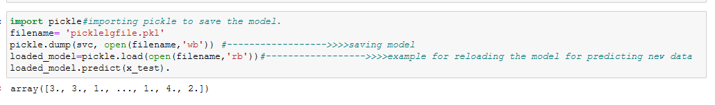
Save Model
We can save the model with pickle or Joblib. Here we imported Pickel.

